Slide 1
Final Year Project Presentation
LeadNext- A lead generator for enhanced customer accessibility and business reach
Carried out by:
1MV13CS042 : JOHN RAHUL R
1MV14CS005 : ABHINAV A NAIR
1MV14CS010 : AKHIL S MENON
1MV14CS130 : SHREYAS NARASIMHA
Under the guidance of:
MRS. K P MAYURI
ASST. PROFESSOR, DEPARTMENT OF CSE

Slide 2
Outline
Introduction
Literature Review
Hardware and Software requirements
System Design
Implementation
Testing
Results and Snapshots
Conclusion
Future Enhancements
Bibliography

Slide 3
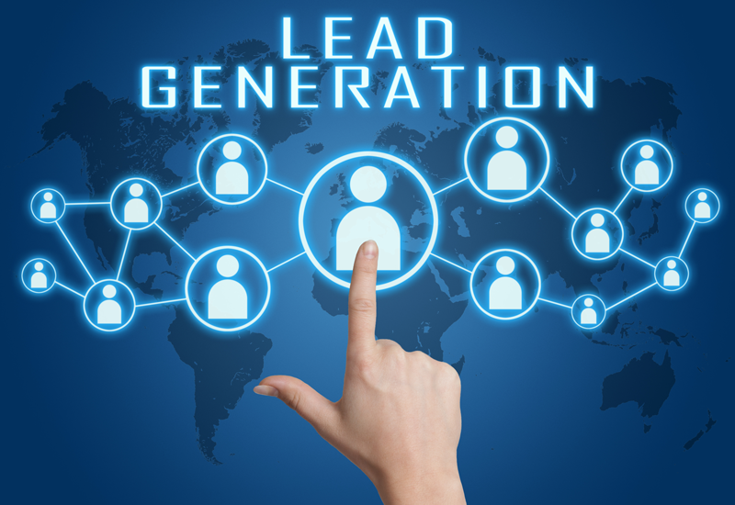
Introduction
Data analytics is defined as “a process of examining data sets in order to draw conclusions about the information they contain, increasingly with the aid of specialized systems and software”. An important term used in the marketing industry is Lead generation. Lead generation describes the marketing process of stimulating and capturing interest in a product or service for the purpose of developing a sales pipeline. Lead generation often uses digital channels, and has been undergoing substantial changes in recent years from the rise of new online and social techniques.

Slide 4
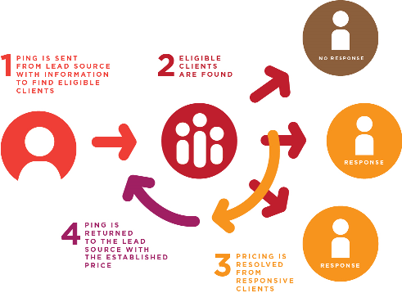
Literature Review
We developed a combined solution for both ends of the spectrum which bridges the gap
between supply and demand by providing prospective consumers to the businesses and
providing the consumers with products based on their interests online.
omnichannel marketing reaches target consumers across all channels -- mobile, video,
desktop, and more -- within the context of how they've interacted with a brand.
An integrated marketing plan is essential to any business, including elements of both outbound and inbound lead generation. Outbound includes emails, cold calling, direct mail pieces, etc. Inbound consists of all things digital: social media channels, PR, websites, etc.

Slide 5
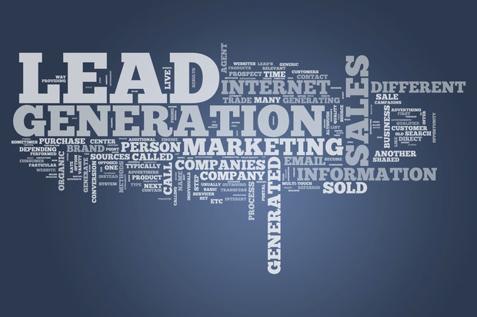
Hardware And Software Requirements
HARDWARE REQUIREMENTS:
Computer with minimum 512Mb RAM
Processor 1.8Ghz
SOFTWARE REQUIREMENTS:
Operating System: Windows/ Linux/ Mac Os
Tools and Packages: Pycharm IDE, Apache web server
Programming language: Python 3.6

Slide 6
System Design
Python:-
Python is an increasingly popular tool for data analysis. In recent years, a number of libraries have reached maturity, allowing R and Stata users to take advantage of the beauty, flexibility, and performance of Python without sacrificing the functionality these older programs have accumulated over the years.
Php7:-
PHP (recursive acronym for PHP: Hypertext Preprocessor) is a widely-used open source general-purpose scripting language that is especially suited for web development and can be embedded into HTML.
Apache 2.4:-
The Apache HTTP Server Project is an effort to develop and maintain an open-source HTTP server for modern operating systems including UNIX and Windows. The goal of this project is to provide a secure, efficient and extensible server that provides HTTP services in sync with the current HTTP standards.
MySql:-
MySQL is most often associated with web-based applications and online publishing and is an important component of an open source enterprise stack called LAMP.
Html:-
HTML is used to create electronic documents (called pages) that are displayed on the World Wide Web. Each page contains a series of connections to other pages called hyperlinks.
Css:-
CSS helps Web developers create a uniform look across several pages of a Web site. Instead of defining the style of each table and each block of text within a page's HTML, commonly used styles need to be defined only once in a CSS document.

Slide 7
Implementation
Browsing History:-
Office Browsing History extension keeps track of the time spent on different websites, and produces analytics that reveal your browsing profile and habits.
Parsing Keywords:-
Keyword analysis is the process of analyzing the keywords or search phrases that bring visitors to your website through organic and paid search. As such, keyword analysis is the starting point and cornerstone of search marketing campaigns.
Create A Database Of Keywords:-
A database is simply an organized collection of related data, typically stored on disk, and accessible by possibly many concurrent users. Databases are generally separated into application areas. For example, one database may contain Human Resource (employee and payroll) data; another may contain sales data; another may contain accounting data; and so on. Databases are managed by a DBMS.
Matching Keywords With Company Dictionary:-
For paid search advertisers, choosing the right keywords can be the difference between a profitable campaign and the advertising equivalent of flushing money down the toilet. However, it’s not enough just to pick the right keywords—you also need to pick the right match type.
Show Recommended Ads

Slide 8
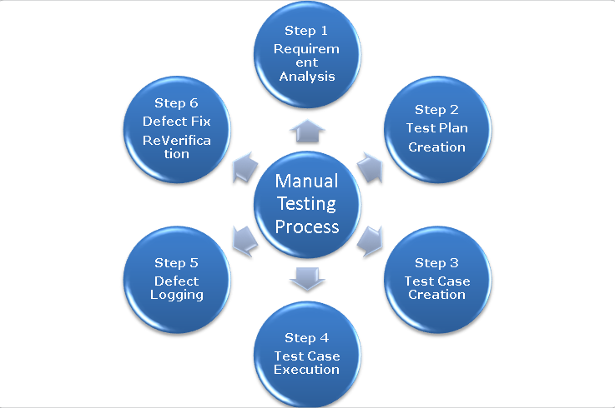
Testing
Software testing is the most critical phase in the development life cycle. Testing performs a very critical role for quality assurance and ensuring the reliability of the software. Software testing represents the ultimate review of specification design and preview.
During the development of software, errors can be injected at any stage. However requirements and design errors are likely to remain undetected. Those errors will be ultimately reflected in the code. During testing,the program to be tested is executed with a set of test cases and output of program for test cases are evaluated to describe the program performance to expected level

Slide 9
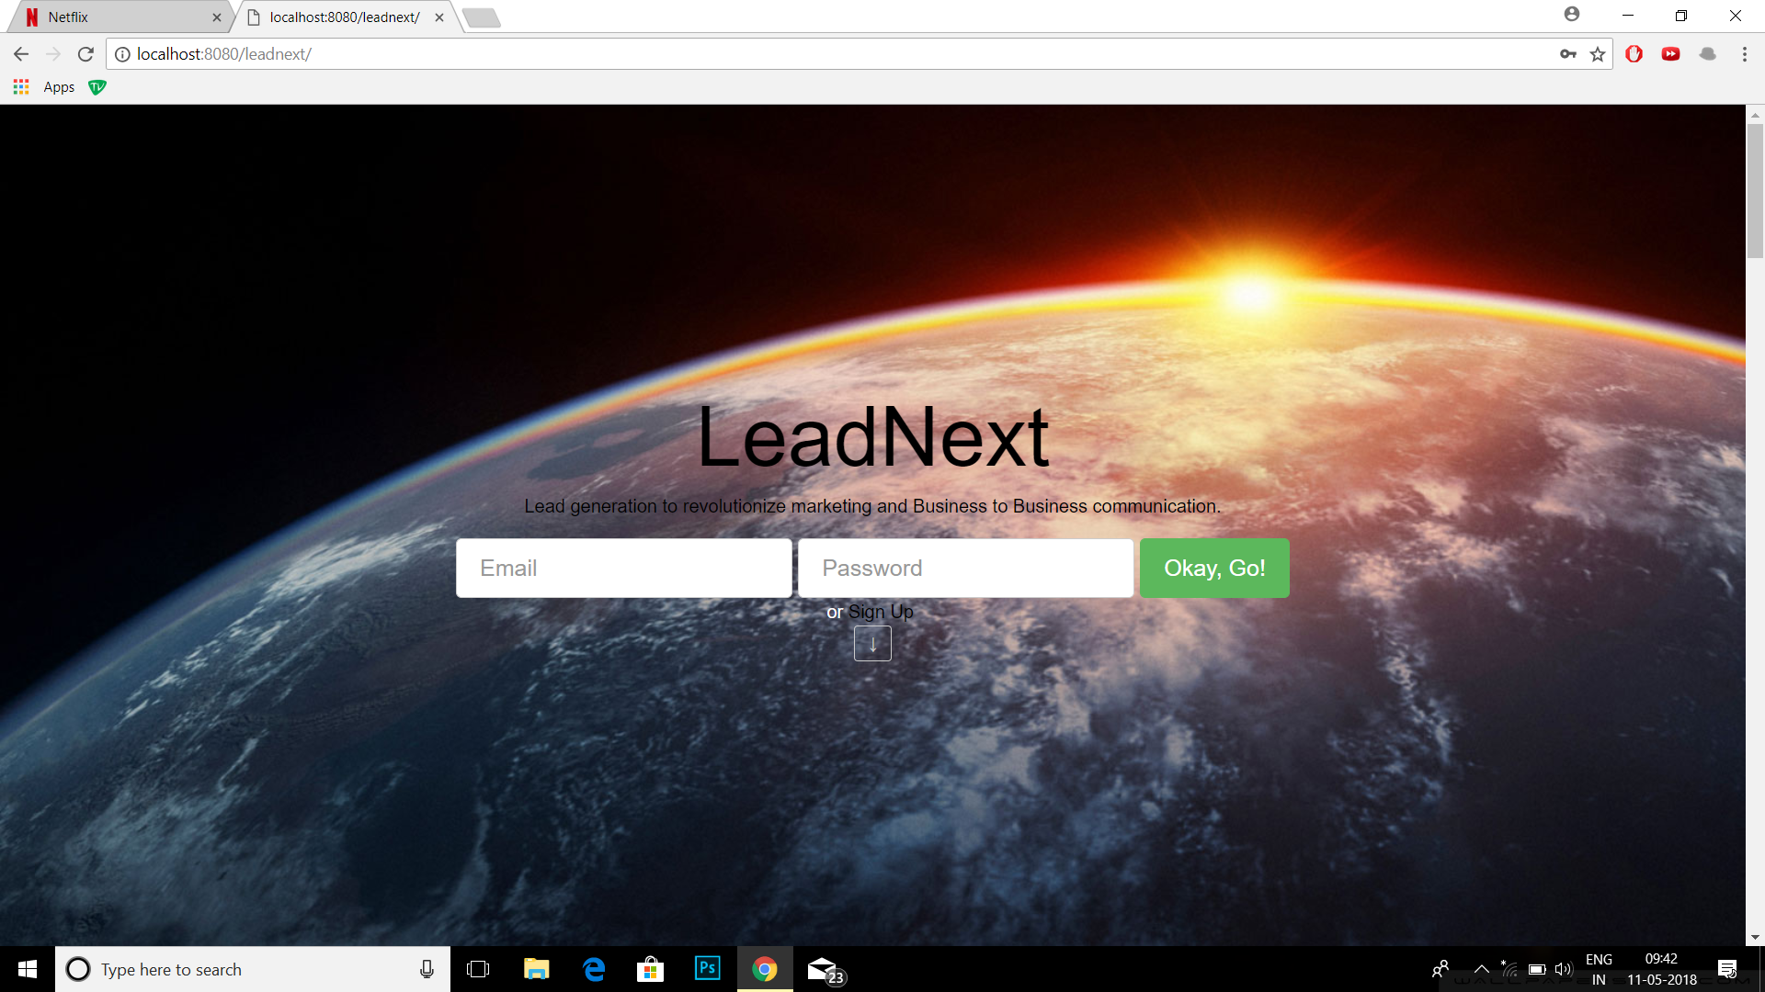
Results And Snapshots

Slide 10
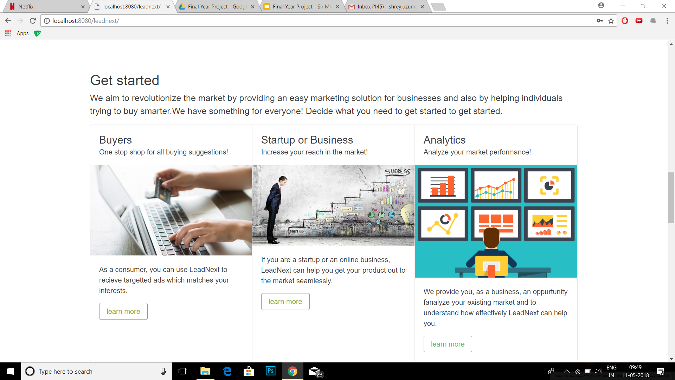

Slide 11
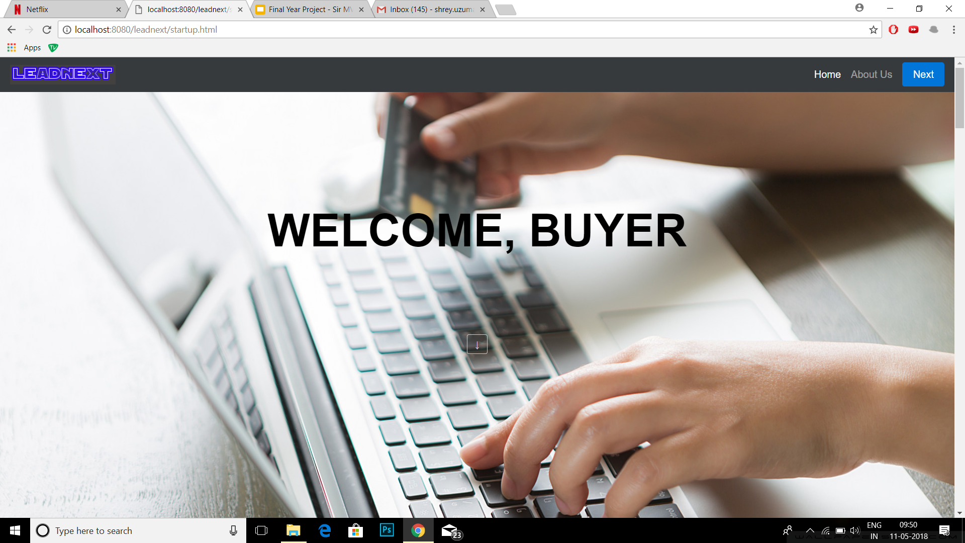

Slide 12
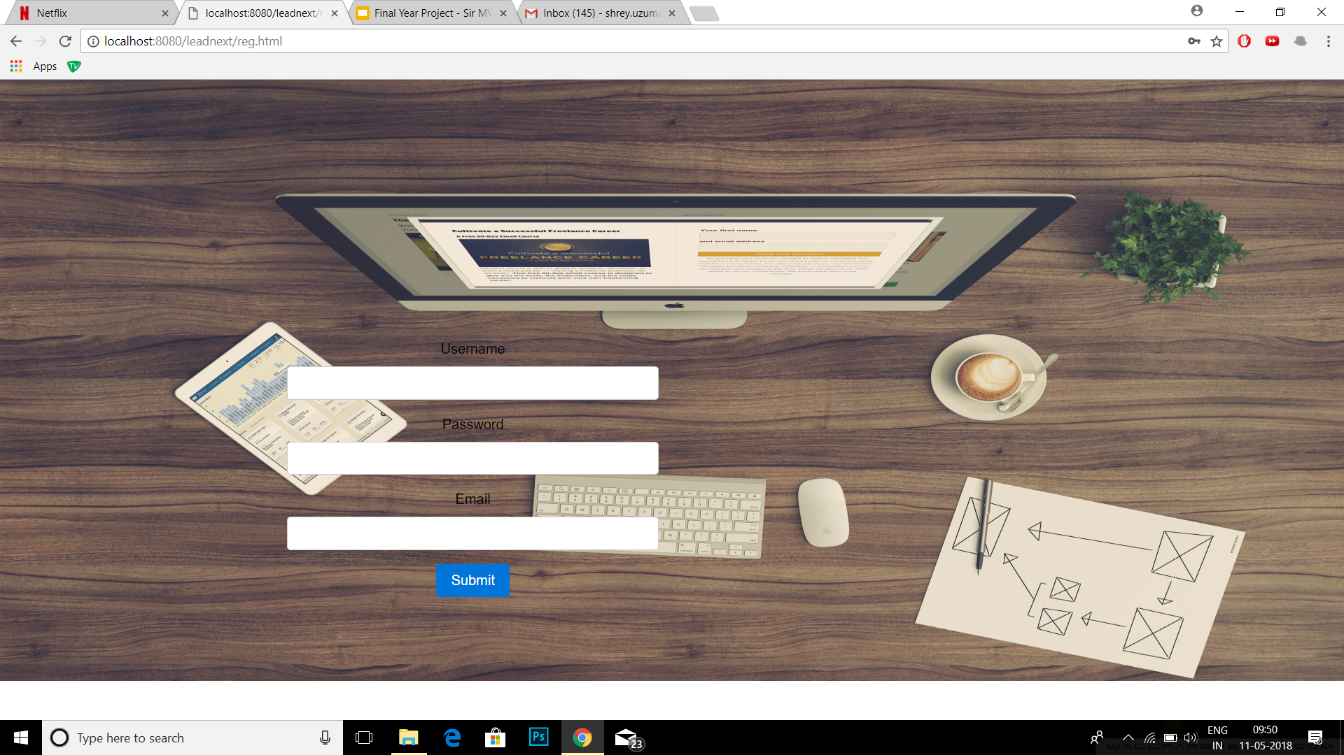

Slide 13
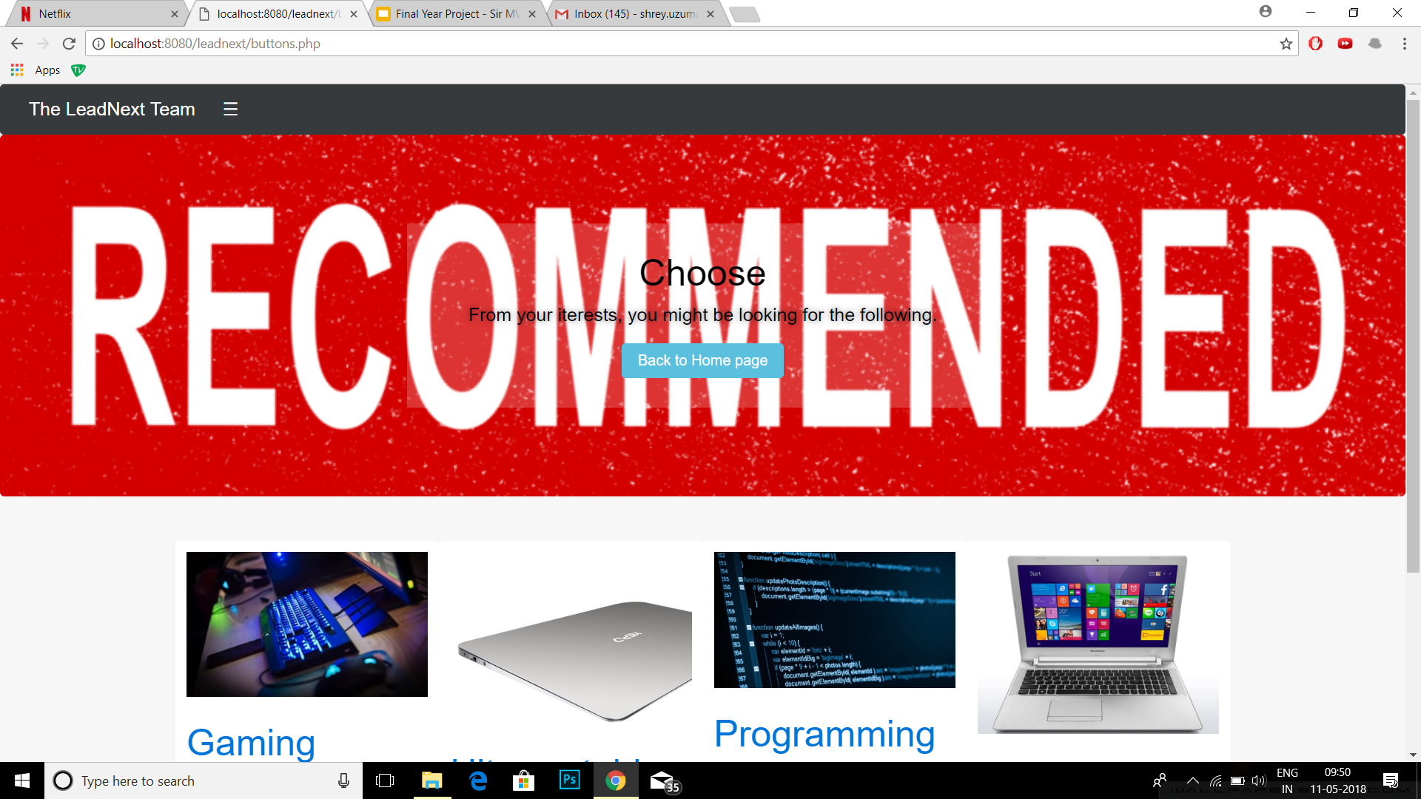

Slide 14
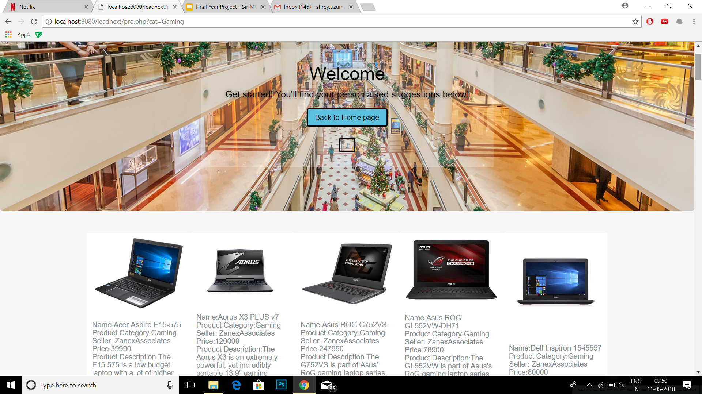

Slide 15
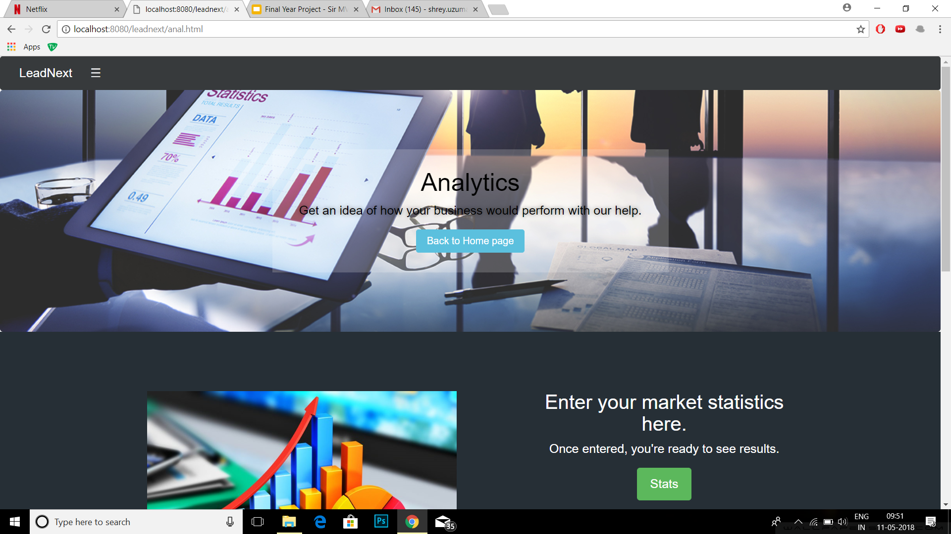

Slide 16
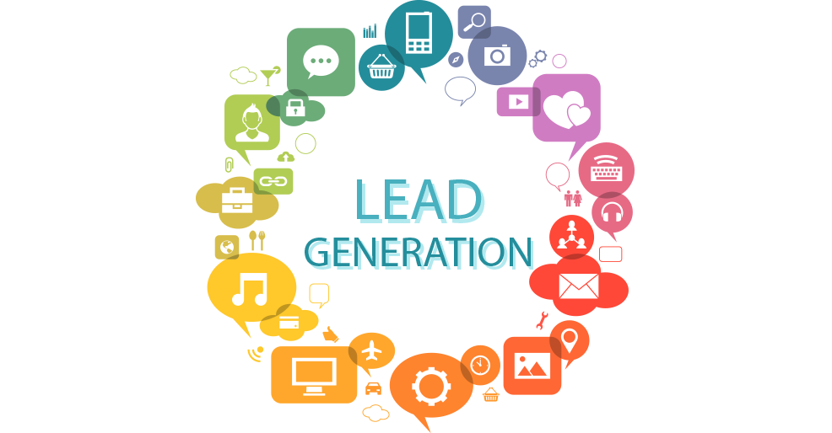
Conclusion
This product is a complete solution for the two major parties involved in any business transaction. It bridges the gap between supply and demand and attempts to satisfy both the consumers who want product suggestions at the click of a button at low prices as well as businesses which want to extend the reach of their products.
The use of a modular method to generate leads, and isolation of different databases allows modifications to be made easily and essentially makes the product future proof. The product could be customized for different organizations with contracts and would allow for the side by side growth of partner organizations.

Slide 17
Future Enhancements
● Scalable to the B2B marketplace.
● Machine learning & AI would be used for auto-scaling platform performance.
● Adding more partner channels.
● Vendor rating/ranking & feedback.

Slide 18
References
http://www.sciencedirect.com
http://www.ee.washington.edu/research
http://www.slideshare.net
http://www.heartlandscience.org
Wiley online library
Wikipedia, the free encyclopedia - https://en.wikipedia.org/
https://en.wikipedia.org/wiki/Web_browsing_history
https://www.marketo.com/lead-generation/
https://en.wikipedia.org/wiki/Lead_generation
https://www.datacamp.com/courses/introduction-to-relational-databases-in-python
https://en.wikipedia.org/wiki/Web_browsing_history
https://ieeexplore.ieee.org/document/4053280/

Slide 19
Thank You

